Slide 1



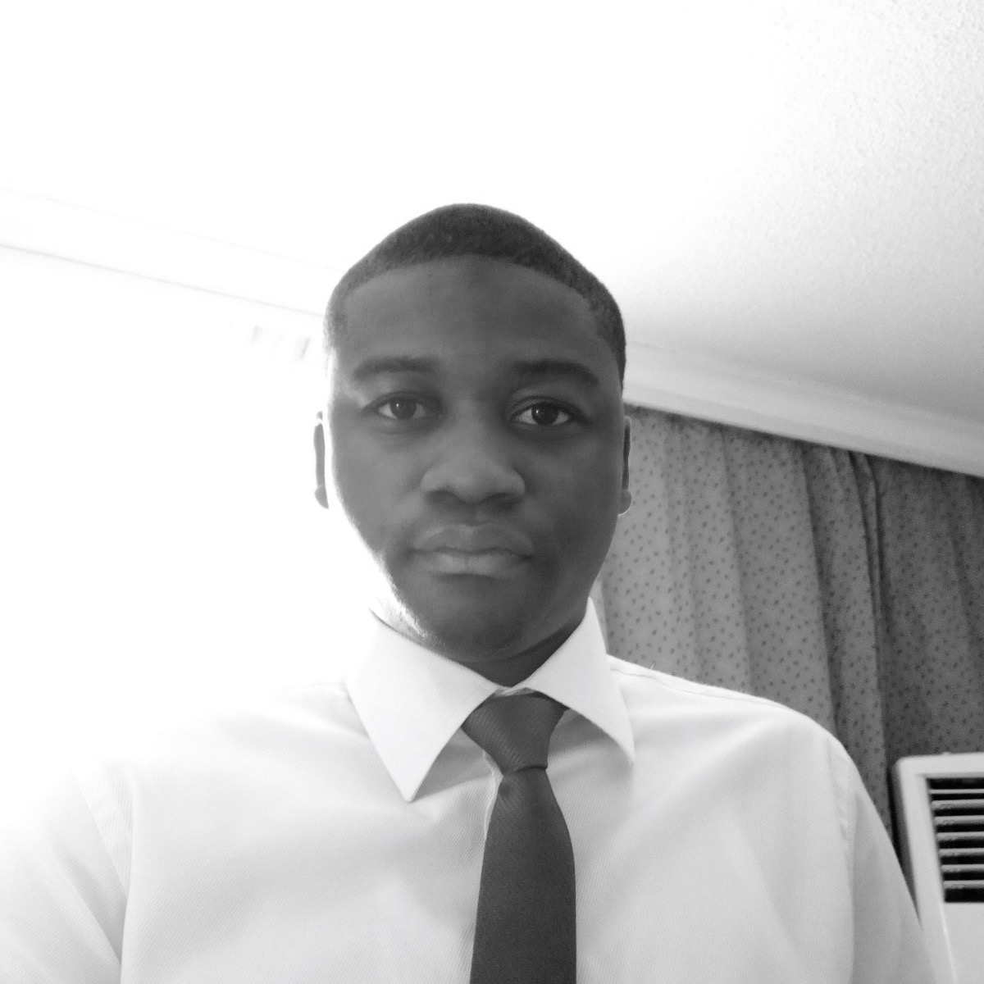

Elias Bakare – Associate
Professional experience
Education and skills
3 years management consulting experience designing strategies, and implementing models that improve the livelihood of the most vulnerable population in Africa – smallholders (Sahel Consulting)
Develop a 5-year strategic plan and 2-year implementation plan for the National Agricultural Seed Council to improve the agency’s regulatory capacity, increasing its certification oversight by ensuring availability of quality seeds in Nigeria
Conducted an outgrower research across three private-sector agro-processing partner companies (across over 5,000 farmers) in Nigeria
Developed sales training manual and conducted sales and marketing training for 8 seed companies’ sales team in Nigeria and Ghana
Conducted a policy study across 3 Nigerian states providing the FG with necessary policies to transform the intermediate technology landscape in the agriculture sector in Nigeria
Additional 3 years management consulting experience supporting SMEs unlock value and deliver enduring results
Increased the revenue base of a hospitality company in Nigeria by expanding its presence to mapped commercial zones in Nigeria and developing a franchise model to support its business expansion
Supported a prominent mining company in Nigeria to secure an equity funding of $8.7 million by developing an investment proposal and incorporating a robust financial model that supported the proposal
Elias holds a Bachelors degree in Computer Engineering from Obafemi Awolowo University, Nigeria
He also holds an Executive Management Degree in Agribusiness Management from Lagos Business School, Nigeria
Elias also hold a certificate from Harvard Business School, Boston, US in Sustainable Business Strategy
Elias speaks English and Yoruba fluently
Introduction
Elias is a young and enthusiastic management consultant with over 6 years of meaningful experience managing projects, solving complex problems in a structured manner, leading teams to deliver value to stakeholders, analyzing markets for key insights and engaging clients majorly across agriculture, technology, healthcare, hospitality, fashion and energy sectors.
I am passionate about doing meaningful work – work that impacts lives and transforms communities. For me, it is a lot around supporting businesses to deliver extraordinary value across all stakeholders – doing good and doing well.

